Slide 2
The video for this presentation can be found here
Notes:
https://channel9.msdn.com/Events/Connect/2017/K101

Slide 3
Building the intelligent apps of the future
Seth Juarez
Cloud Developer Advocate
Notes:
Introduction
What is this session about? Invited some friends to show what is an application of the future, all demos.

Slide 4
What is an application of the future?
Notes:
So what is an application of the future? Let me go through my day yesterday to get here.

Slide 5

Notes:
Wake up (smart alarm)

Slide 6

Notes:
Checked social media (added a picture that was recognized, interacted with publisher by asking for delivery details on an order, added a friend I hadn’t seen in years)
Added a picture
Suggested a friend
*Can* interact with a publisher

Slide 7

Notes:
Flight to get here (maybe 7m of the flight controlled by humans)
“In a recent survey of airline pilots, those operating Boeing 777s reported that they spent just seven minutes manually piloting their planes in a typical flight. Pilots operating Airbus planes spent half that time.”
On the plane I checked some email (SPAM catcher)
… and checked into my online deep learning course (adaptive learning)
Did some shopping! (suggestions rule here, search, etc.)
Played a game!

Slide 8

Notes:
Arrived at the airport and used a ride share app to get to where I was going

Slide 9
What is an application of the future?
AI-INFUSED
NEW EXPERIENCES
DATA-DRIVEN
Notes:
What do all these applications have in common?
Apps of the future has AI infused. They are intelligent, they learn over time.
They provide new experiences that remove barriers between people and technology (because they are AI infused).
They sit on top of huge amounts of data and they leverage that data to make them better
Today we’re going
Today we’ll peel back the hype to show you how to infuse AI in your applications *today*
Real demos, of Real things, that you can Really do today

Slide 10
INFUSING AI
Notes:
Artificial Intelligence is anything that makes machines smart
Machine learning is a technique for doing that, a very popular one
You can create machine learning models, we will see that later in this session
BUT, what if you can use machine learning like using a library?
Like pdf libraries – we are happy to call them but none of us know how they work
We are very comfortable with abstraction
As developers we should not be afraid to use these machine learning libraries
Instead of trying to be intelligent about the libraries we write, let’s instead use intelligent libraries
We have the services and tools to do it:
Services: Cognitive services

Slide 11

Cognitive Services
Anna S. Roth
@annasroth

Slide 12
AI Infused Xamarin Apps
Miguel de Icaza
@migueldeicaza

Slide 13
NEW APP EXPERIENCES
Notes:
Notice how easy it was to infuse AI into a standard application
You could have easily called the rest API
Here, we used CoreML locally
As you were watching, hopefully you were inspired by these services and how you can incorporate them into your existing applications
SUMMARY – Applications of the future are AI infused
TRANSITION – Applications of the Future provide New App Experiences
Technology is moving to a place where computers need to adapt to us and not the other way around
“You’re not using it right” is no longer something we can say
Great example of this new style of these new app experiences are bots

Slide 14
Adding Intelligence to Bots
Heather Shapiro
@microheather

Slide 15
DATA-DRIVEN
Notes:
SUMMARY (AI Infused, New App Experiences)
The other key attribute we saw is data-driven.
Apps of the future sit on top of huge amounts of data.
The data volumes are exploding, more data has been created in the past two years than in the entire previous history of the human race.
Data is growing faster than ever before and by the year 2020, about 1.7 megabytes of new information will be created every second for every human being on the planet.
You, as a developer, will take the most out of that data to provide great experiences to your users. It could be recommending a shopping item, finding you a friend, removing spam from your inbox or estimating the arrival time for your car.
That is the concept of machine learning.

Slide 16
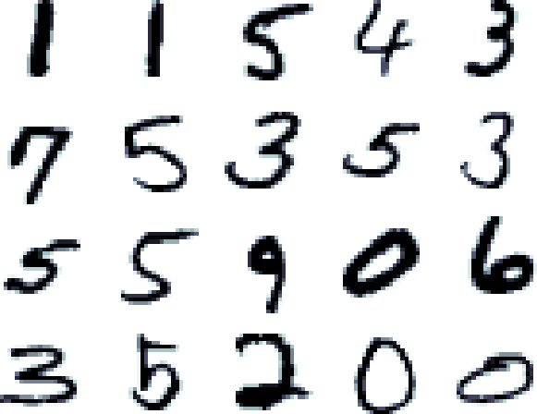
Notes:
Your boss comes in and says, you need to create an application that can read numbers
How would you go about doing that?
Input
Output
Examples
Algorithms
For 1s – look for black pixels in the middle
7s?
Get a problem – make steps

Slide 17
Machine Learning
STEPS
EXAMPLES
CODE
MODELS
Notes:
The other approach to this problem is machine learning
In machine learning, we don’t talk in terms of steps that we program anymore, we use examples and we make the computer think about the steps.
We don’t use code anymore, we create models that are able to learn from those examples

Slide 18
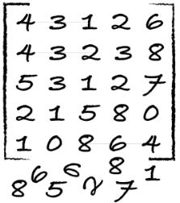
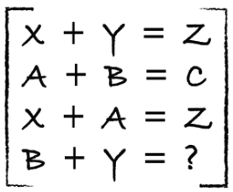
IDENTIFY
PREDICT
?
1
4
EXPLORE • ANALYZE • CONVERT
MODEL
2
3
Notes:
The process we follow to use machine learning are different than the one we use for traditional development

Slide 19
Tools
CODING TOOLS
Visual Studio Code Tools for AI
Azure Machine Learning Studio
Azure Machine Learning Workbench
Others (PyCharm, Jupyter Notebooks…)
FRAMEWORKS
Cognitive Toolkit
TensorFlow
Caffe
Others (Scikit-learn, MXNet, Keras, Chainer, Gluon…)
Notes:
So as developers we like tools, what are the tools you can use for this new way of development?
You have to separate in two things: tools and frameworks
In Microsoft we love providing the tools that make you productive and AI is no different. At Ignite we released VS Code Tools for AI, which helps you create these models from Visual Studio Code. We also provide Azure Machine Learning Studio, where you can basically use drag and drop to create your models. We also released at Ignite Azure Machine Learning Workbench, which can help you be more productive working with the data wrangling needed for AI.
And just like we always do in Microsoft now, these tools work on top of any framework
So what tool is missing here? There’s one tool that we all love which is missing here. Today, I’m happy to announce a new member of this AI toolset… Visual Studio!!

Slide 20
Visual Studio Tools for AI
ANNOUNCING
PREVIEW
Notes:
Visual Studio Tools for AI is an extension to the Visual Studio IDE that help you create AI models easily and be very productive, the Visual Studio way. Think about all the wonders of Visual Studio but focused on AI model development, Intellisense, debugging, code editing… All integrated with Azure services so you can leverage the cloud from the IDE to scale your development and deploy anywhere.
Let’s see it in a demo…

Slide 21
Visual Studio Tools for AI
Seth Juarez
@sethjuarez
Notes:
End of demo:
So, we can build the model and we can train it using Azure VMs or Azure Batch AI.
But I can see another node in here… Azure Machine Learning.
You know better than anybody than when the project gets more complex you need better management. You need source control for models, you need to manage the data that was used on each experiment, and compare experiments no matter who created them, or collaborate with other people in the team. That’s Azure Machine Learning, and you have it fully integrated with Visual Studio Tools for AI.
[move to slides]

Slide 22
Azure Machine Learning
Spark
SQL DB
Virtual Machines
GPUs
Container services
Azure
On-premises
SQL Server
Machine Learning Server
EXPERIMENTATION AND MODEL MANAGEMENT
Edge computing
Azure IoT Edge
Notes:
The other big thing that Azure Machine Learning provides is model management.
Once you have the model, you have to deploy the model somewhere and that is exactly what Azure Machine Learning does too.
When can you deploy the model? Well, it depends… If you are creating a check recognition you will probably host this AI model in the cloud. But if you are creating a self-driving car you may want this model to be in the car itself, to get better latency and don’t crash when you get in a tunnel. Or you may want to deploy it on-premises, if you have your data there.
Azure Machine Learning can help you deploy that AI on any of those places. I can deploy it to the cloud, on a virtual machine, a container or even in SQL DB. Or I can use Spark for huge scale.
I can also deploy it on-premises, directly to my SQL Server where the data is or in Microsoft Machine Learning Server.
And finally, I can even deploy it all the way to the edge. Azure Machine Learning is integrated with Azure IoT Edge, so you can deploy these models to your IoT devices, like a factory or why not, a self-driven car is that’s your thing.

Slide 23
Azure IoT Edge
ANNOUNCING
PREVIEW
Notes:
Actually, today we are announcing the public preview of Azure IoT Edge too so you have all the pieces you need to deploy your models all the way from the cloud to the IoT Edge. Azure IoT Edge is integrated with Azure Machine Learning, so directly from there you can deploy your models to your IoT devices. Very cool.

Slide 24
Consuming AI from .NET
Scott Hanselman
@shanselman
Notes:
What about .NET? I know a lot of you are .NET developers. We also have you covered. One of the targets you have available for running these models is .NET, so you can use it directly from your .NET applications.

Slide 25
Develop the apps of the future today
aischool.microsoft.com
Notes:
I hope this session helped you a little bit for getting started with AI. Remember the three things you can do:
Infuse AI in your applications. You can use Cognitive Services and with just a little bit of code you can add magic to your applications.
Create new experiences. You can use Bot Service and LUIS to create intelligent bots that understand your users.
Reason on top of your data. You can create your own AI models and we provide the tools and the services to make it easier for you and more productive.
If you want to learn more about AI and become an AI developer, today we are launching the AI school. A place where we will keep posting courses and resources for you to learn all the techniques to be an AI developer.
Thank you!!

